Slide 1
CUSTOMER RELATIONSHIP MANAGEMENT
B.Divya Rajya Lakshmi
K. Vijay Krishana
K. Ramya

Slide 2
Introduction:
Customer Relationship Management (CRM) is a complete method that firms use to manage
interactions and connections with present and potential customers. It entails using technology,
processes, and practices to evaluate customer data and optimize customer interactions across the customers lifecycle.

Slide 3
Importance:
In Today’s competitive cooperative environment, customer focus is critical.
CRM allows organizations to better understand their customers ’ requirements and preferences.
It provides personalized and targeted marketing, sales, and service initiatives.
CRM fosters stronger customer relationships, which leads to higher loyalty and retention.
Finally, CRM promotes corporate growth and profitability by increasing client lifetime value.

Slide 4
Benefits:
Enhanced Customer Satisfaction: Deliver personalized experiences and timely support.
Improved Sales Performance: Increase sales efficiency, lead conversion rates, and deal sizes.
Effective Marketing Campaigns: Targeted marketing efforts leading to higher ROI.
Better Customer Retention: Nurture long-term relationships and reduce customer churn.
Data-Driven Decision Making: Utilize insights to make informed business decisions.

Slide 5
Code Implementation(C++):
#include <iostream>
#include <vector>
#include <string>
These lines are known as preprocessor directives in C++. They are instructions to the compiler to include certain header files before compiling the rest of the code. Here's what each directive does:
#include<iostream>: It provides functionality for basic input and output operations, allowing you to interact with the console or terminal.
#include<vector>: It allows you to store a collection of elements of a specified type and provides various methods to manipulate the elements efficiently.
#include<string>: It provides various methods for string manipulation, such as concatenation, substring extraction, and comparison.
Finally, These directories are essential for performing input/output operations, working with dynamic arrays, and manipulating strings, respectively.

Slide 6
// Customer structure
struct Customer {
std::string name;
std::string email;
std::string phone;
std::string address;
};
This code defines a C++ structure named ‘customer’, which serves as a blueprint for representing the details of a customer.
struct Customer {…………….};---- this defines a structure named “customer”: A structure is a user-defined data type in C++ that allows you to group related variables of different data types under a single data type.
Std::string name; std::stirng email; std::string phone; std::string address;----these lines declare four member variables inside the customer structure.
Name: represents customer name, email: represents customer email, phone: represents customer phone number, address: represents customer address.
By using “std::string “ you can store and manipulate strings of variable length conveniently. It is a part of C++ library and provides various methods for string manipulation, making it suitable for storing textual data like names, emails, phones numbers, and addresses.

Slide 7
// CRM System class
class CRMSystem {
private:
std::vector<Customer> customers;
public:
class CRMSystem: This declares a class named “CRMSystem” which represents a customer management system.
private: This keyword indicates that the member variables and member functions declared below it are private and can only be accessed within the class.
std::vector<Customer> customers; : This line declares a private member variable named “customers;” which is a vector containing objects of the Customer structure.

Slide 8
// Function to add a new customer
void addCustomer(const std::string& name, const std::string& email, const std::string& phone, const std::string& address) {
Customer newCustomer;
newCustomer.name = name;
newCustomer.email = email;
newCustomer.phone = phone;
newCustomer.address = address;
customers.push_back(newCustomer);
std::cout << "Customer added successfully.\n";
}
void addCustomer(const std::string& name, const std::string& email, const std::string& phone, const std::string& address) : this declares a member function named “addCustomer” which takes four parameters(name,email,phone,address) and adds a new customer to the “Customer” vector.
Inside the function, a new “customer” object is created and initialized with the provided details. Then, this object is added to the “Customers” vector using the “push_back” method.
Finally, a message is printed to indicate that the customer is added successfully.

Slide 9
// Function to display all customers
void displayCustomers() const {
if (customers.empty()) {
std::cout << "No customers found.\n";
}else {
std::cout << "All Customers:\n";
for (const auto& customer : customers) {
std::cout << "Name: " << customer.name << "\n";
std::cout << "Email: " << customer.email << "\n";
std::cout << "Phone: " << customer.phone << "\n";
std::cout << "Address: " << customer.address << "\n\n";
}
}
}
void displayCustomers() const {………} – Declares a member function named “displayCustomers” which displays all the customers stored in the “customer” vector.
Inside the function, it checks if the “customer” vector is empty. If it is empty it prints a message indicating that no customers are found. Otherwise, it iterates through each customer in the vector and prints their details(name, email, phone, address).
The main() function interacts with the user to add customers and display them using the “CRMsystem” class and its member function. The user is prompted to enter customer details, and the program adds the customer to the system. Finally, the program displays all the customers entered by the user.

Slide 10
int main() {
CRMSystem crmSystem;……………..};
The main() function is the entry of the program.
“CRMSystem crmSystem”: this line creates an object named “crmSystem” of the “CRMSystem” class. The object will be used to interact with customer relationship management system.
Promting user to add customers:
std::string name, email, phone, address;
char addMore;
these lines declare variables to store customer details(name,email,phone,address) and a variable(Addmore) to determine if the user wants to add more customers.

Slide 11
Adding Customers in loop: // Prompting for Customer Details
do {
std::cout << "Enter customer details:\n";
std::cout << "Name: ";
std::cin >> name;
std::cout << "Email: ";
std::cin >> email;
std::cout << "Phone: ";
std::cin >> phone;
std::cout << "Address: ";
std::cin.ignore(); // Ignore newline character
std::getline(std::cin, address);
// Adding Customer to CRMSystem
crmSystem.addCustomer(name, email, phone, address);
// Asking User to Add Another Customer
std::cout << "Do you want to add another customer? (y/n): ";
std::cin >> addMore;
} while (addMore == 'y' || addMore == 'Y');

Slide 12
Inside a do-while loop, the program prompts the user to enter details for a new customer.
The user is asked for the customer's name, email, phone number, and address.
The addCustomer() function of the crmSystem object is called to add the new customer to the CRM system.
The user is then prompted if they want to add another customer. If the response is 'y' or 'Y', the loop continues; otherwise, it exits.

Slide 13
// Display all customers
crmSystem.displayCustomers();
After the user finishes adding customers, the “displayCustomers();” function of the “crmSystem” object is called to display all the customers stored in the CRMsystem.
Program Termination:
return 0;
This line indicates the end of the “main()” function and returns 0 to the operating system, indicating succesfull program execution.

Slide 14
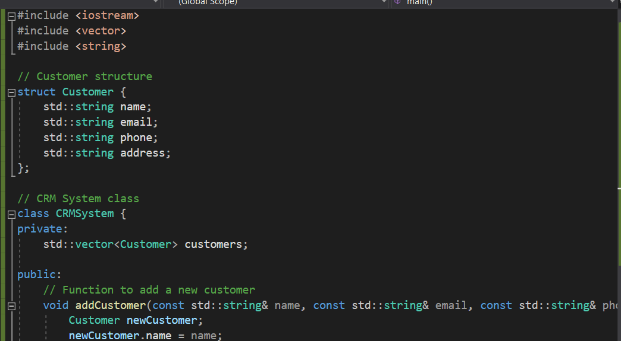
Program Images:

Slide 15
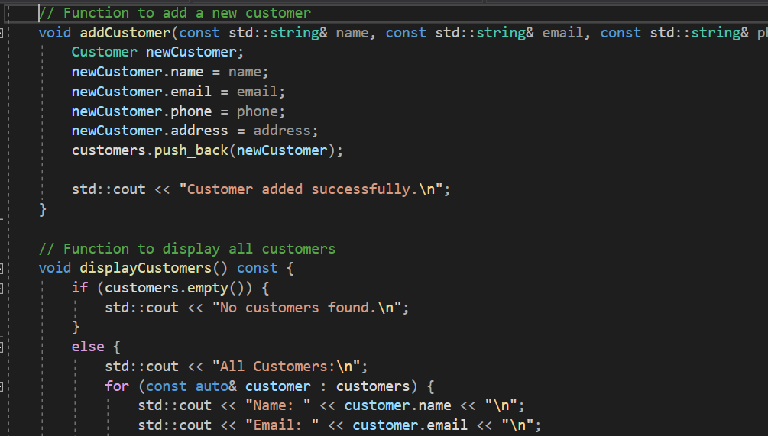

Slide 16
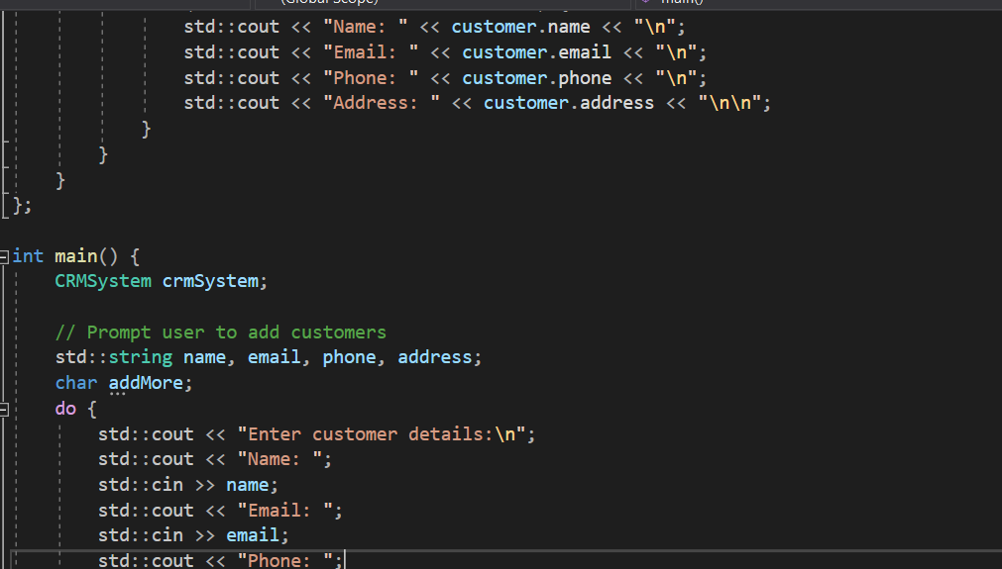

Slide 17
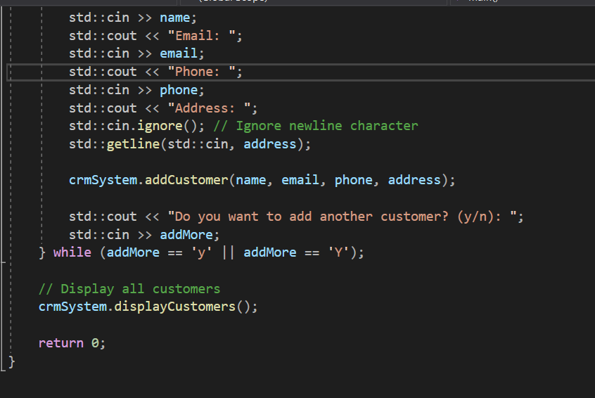

Slide 18
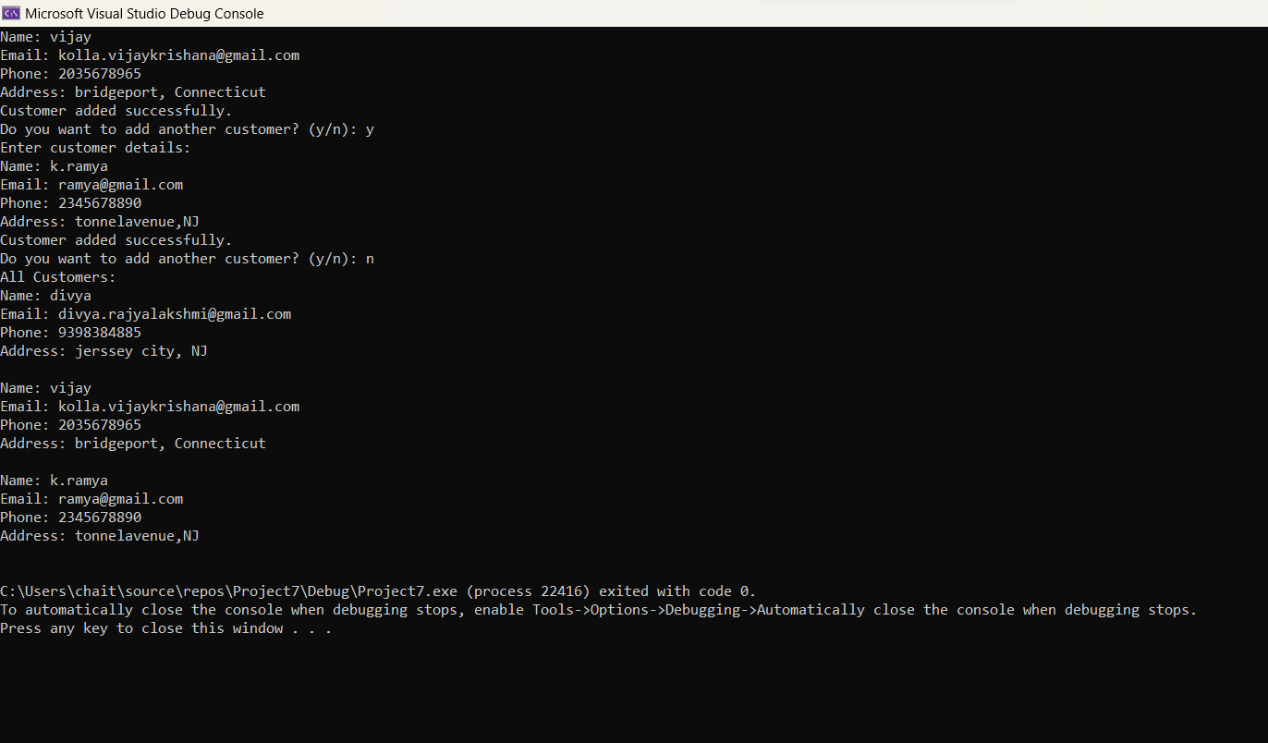
Sample Output:

Slide 19
Thank You

